Slide 1
Survival Analysis

Slide 2
Applications
Business Planning: Profiling customers who has a higher survival rate and make strategy accordingly.
Lifetime Value Prediction: Engage with customers according to their lifetime value
Active customers: Predict when the customer will be active for the next time and take interventions accordingly.
Campaign evaluation: Monitor effect of campaign on the survival rate of customers.
Employee attrition: When will the employee leave?

Slide 3
Industry specific
Banking – customer lifetime and LTV
Insurance – time to lapsing on policy
Mortgages – time to mortgage redemption
Mail Order Catalogue – time to next purchase
Retail – time till food customer starts purchasing non-food
Manufacturing – lifetime of a machine component
Telecom- Time to churn

Slide 4
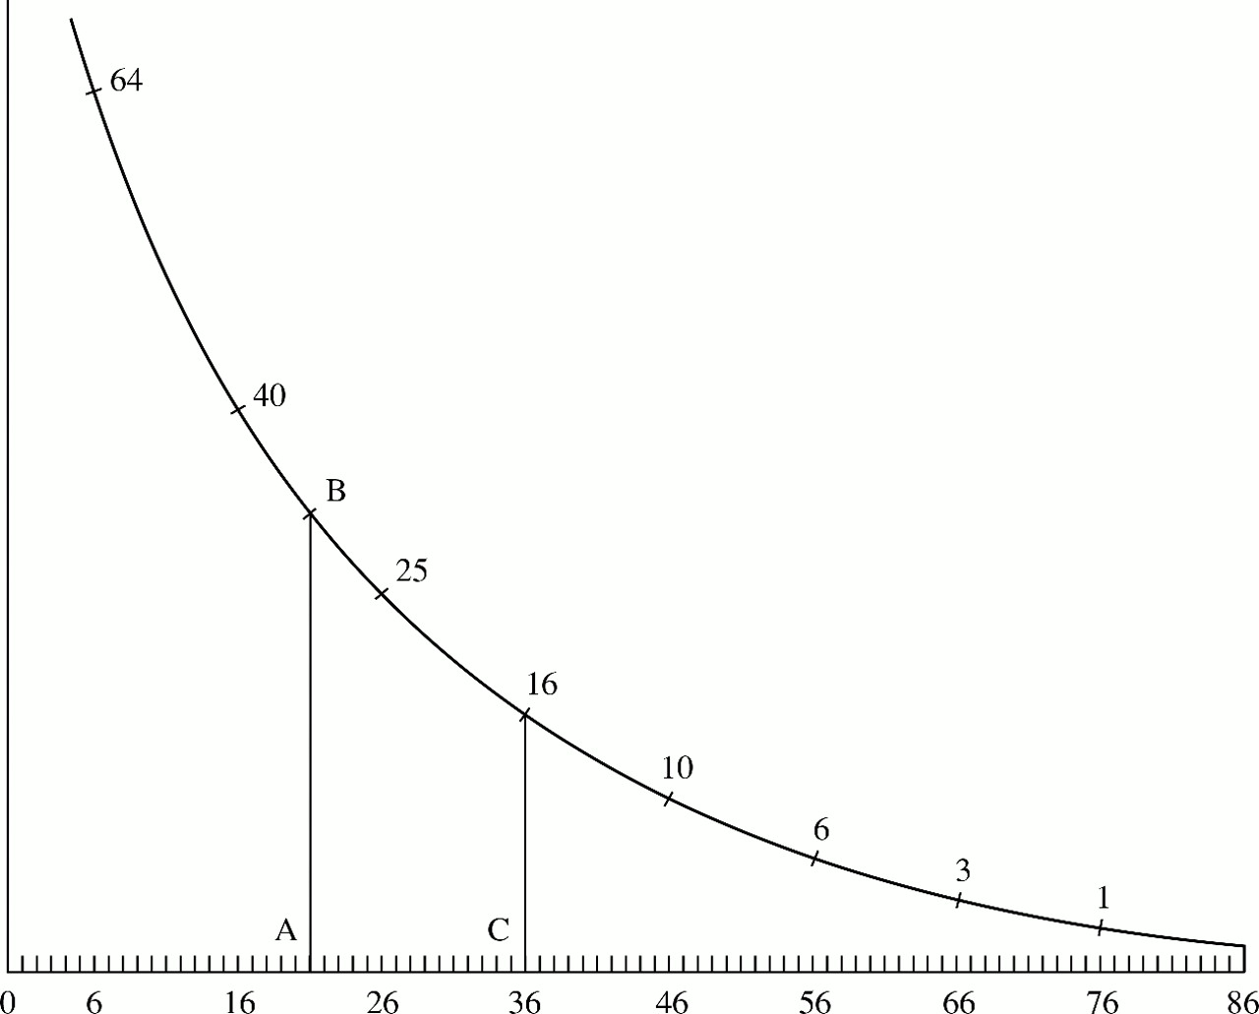

Early example of survival analysis
Christiaan Huygens' 1669 curve showing how many out of 100 people survive until 86 years.
Christiaan Huygens

Slide 5

Early example of survival analysis
Roughly, what shape is this function?
What was a person’s chance of surviving past 20? Past 36?
We are trying to estimate this curve—only the outcome can be any binary event, not just death.

Slide 6

Death?
Survival analysis is modelling of the time to death/event.
Survival analysis has a much broader use in statistics. Any event can be defined as death. For example, age for marriage (!), time for the customer to buy his first product after visiting the website for the first time, time to attrition of an employee etc. all can be modeled as survival analysis.

Slide 7
Objectives of survival analysis
Estimate time-to-event for a group of individuals, such as time until second heart-attack for a group of MI patients.
To compare time-to-event between two or more groups, such as treated vs. placebo MI patients in a randomized controlled trial.
To assess the relationship of co-variables to time-to-event, such as: does weight, insulin resistance, or cholesterol influence survival time patients?

Slide 8
Survival Analysis: Terms
Time-to-event: The time from entry into a study until a subject has a particular outcome
Censoring: Subjects are said to be censored if they are lost to follow up or drop out of the study, or if the study ends before they die or have an outcome of interest. They are counted as alive or disease-free for the time they were enrolled in the study.

Slide 9
New term: Hazard
Survival analysis focuses on hazard function
Hazard: the event of interest occurring
Hazard might be death, engine breakdown, churn, employee attrition, adoption of innovation, etc.
Hazard rate: is the instantaneous probability of the given event occurring at any point in time. It can be plotted against time on the X axis, forming a graph of the hazard rate over time.
Hazard function: the equation that describe this plotted line is the hazard function

Slide 10
Hazard function
Suppose that a person is alive at time t and that her probability of dying in the short time interval ($t,t+∆t)$is $λ(t)∆t$.
Then $λ(t)∆t$ is called a hazard function, sometimes it is given as $h(t)$
More precisely
$$λ\left(t\right)=\frac{P\left(Person dies by time t+∆t\right|Patient alive at time t)}{∆t}$$
For a very large population

Slide 11
Survival curve, what distribution is it ?
One way to describe the survival distribution here is:
P(T>76)=.01
P(T>36) = .16

Slide 12
Survival function
Assuming that the survival is a exponential distribution
If $T\sim exp⁡(λ)$, then
$$P\left(T=t\right)=λe^{−λt}$$
Where $λ$ is a constant rate

Slide 13
Survival function and the hazard
$$λ\left(t\right)=0.01 deaths per person$$
Incidence rate (constant).
Probability of dying at age 10
$$P\left(t=10\right)=0.1e^{−0.1∗(10)}=0.009$$
$$P\left(T=t\right)=λe^{−λt}$$
$$S\left(t=10\right)=e^{−0.1∗(10)}=0.905$$
Probability of surviving past year 10.
$$P\left(T>t\right)=e^{−λt}$$

Slide 14
Data Structure
Two-variable outcome :
Time variable: t_{i} = time at last disease-free observation or time at event
Censoring variable: c_{i} =1 if had the event; c_{i} =0 no event by time t_{i}

Slide 15
Types of survival analysis
Nonparametric: no assumption about the shape of hazard function. Hazard function is estimated based on empirical data, showing change over time, for example, Kaplan-Meier survival analysis.
Semi-parametric: no assumption about the shape of hazard function, but make assumption about how covariates affect the hazard function, for example: Cox regression
Parametric: specify the shape of baseline hazard function and covariates effects on hazard function in advance.

Slide 16
Kaplan-Meier estimates

Slide 17
Kaplan-Meier
The Kaplan-Meier procedure is a method of estimating time-to-event models in the presence of censored cases.
A descriptive procedure for examining the distribution of time-to-event variables. We also can compare the distribution by levels of a factor variable or produce separate analyses by levels of a stratification variable.
Censored cases (right-censored cases) are those for which the event of interest has not yet happened.

Slide 18
Kaplan-Meier: Assumptions
Assumptions
Probabilities for the event of interest should depend only on time after the initial event without covariates (numeric independent variables) effects.
Cases that enter the study at different times (for example, patients who begin treatment at different times) should behave similarly.
Censored and uncensored cases behave the same. If, for example, many of the censored cases are patients with more serious conditions, your results may be biased.

Slide 19
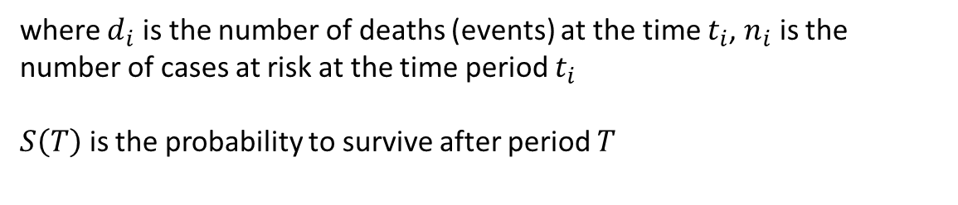
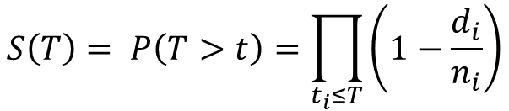
Kaplan Meier estimate
Kaplan-Meier’s survival estimator
$$S\left(T\right)= P\left(T>t\right)=\prod_{t_{i}≤T}{\left(1−\frac{d_{i}}{n_{i}}\right)}$$
where $d_{i}$ is the number of deaths (events) at the time $t_{i}$, $n_{i}$ is the number of cases at risk at the time period $t_{i}$
$S\left(T\right)$ is the probability to survive after period $T$

Slide 20
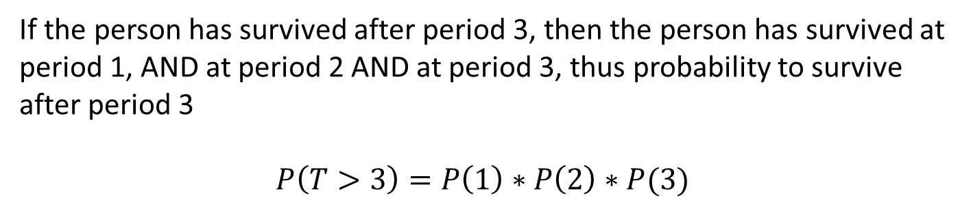
Kaplan Meier estimate
If the person has survived after period 3, then the person has survived at period 1, AND at period 2 AND at period 3, thus probability to survive after period 3
$$P\left(T>3\right)=P\left(1\right)∗P\left(2\right)∗P(3)$$

Slide 21
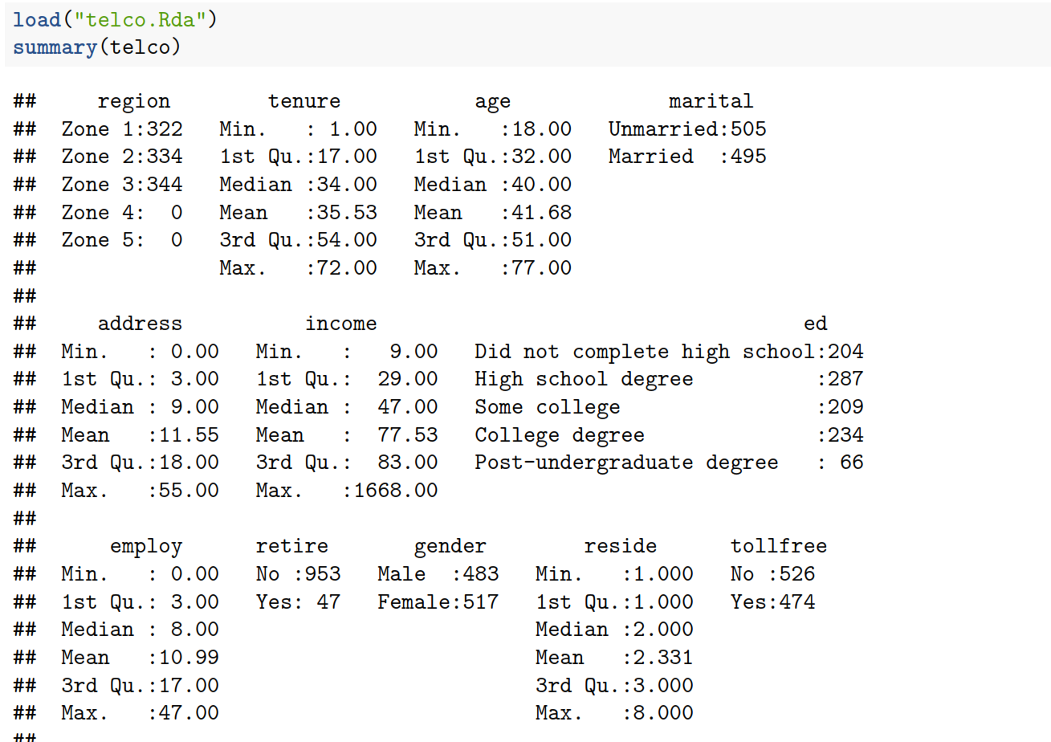
Kaplan-Meier survival analysis
Variables we will model are tenure: How old in months is the customer, churn: if the customer has churned

Slide 22
Kaplan-Meier survival analysis
To run Kaplan-Meier estimates, we first need to transform the indicator variable into numeric, with 0,1
Call “survival” library and create survival object with two parameters [time, event]

Slide 23
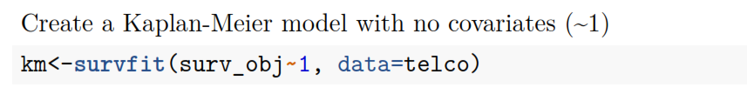
Kaplan-Meier survival analysis
Not how the formula is defined: surv_object~1, where ~1 indicates that we are running a baseline model without predictors

Slide 24
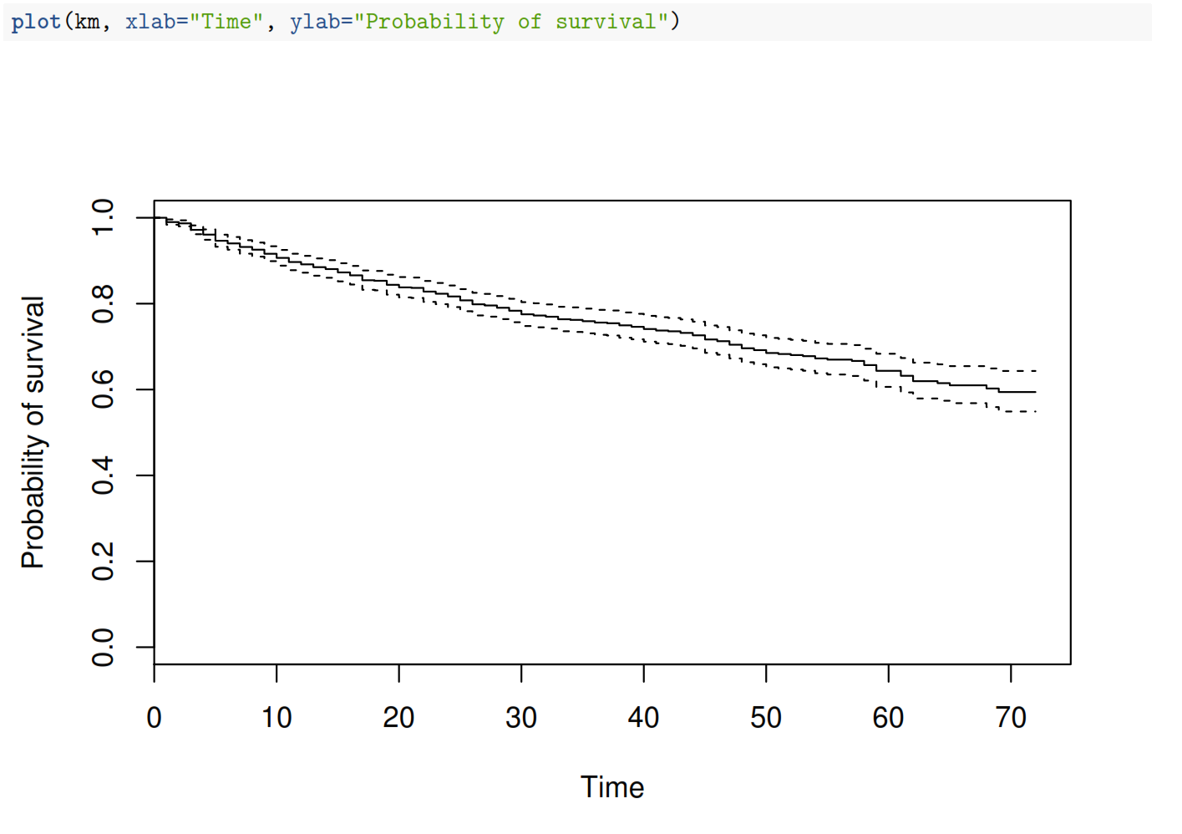
Kaplan-Meier survival analysis

Slide 25
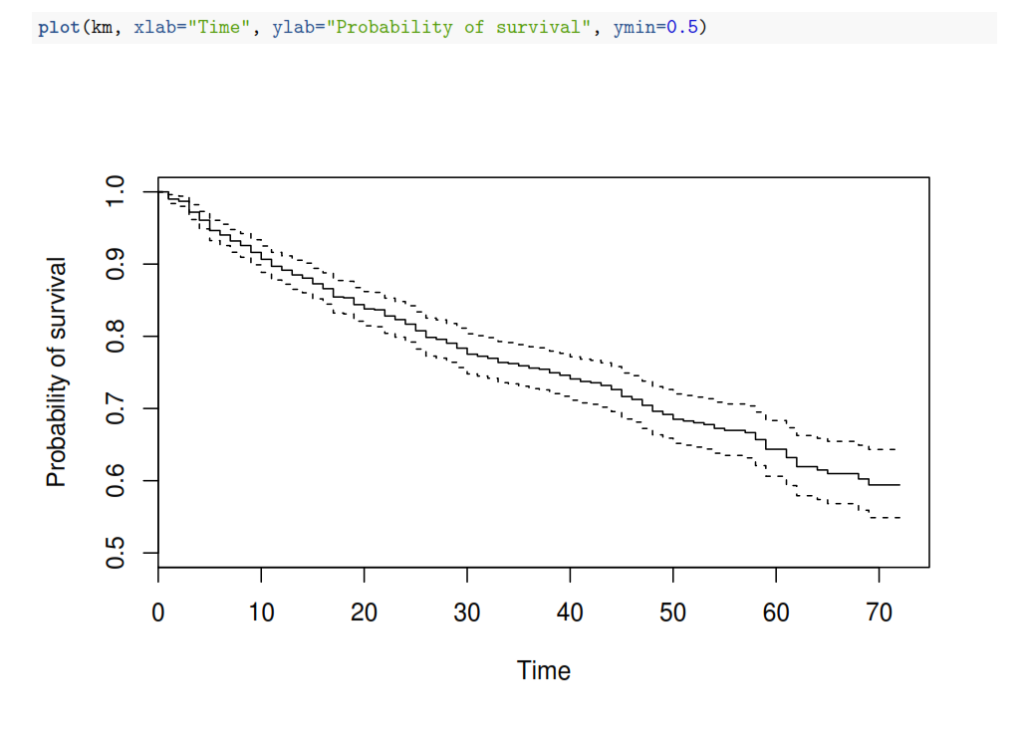
Kaplan-Meier survival analysis
Probability of survival after month 40 is around 75%

Slide 26
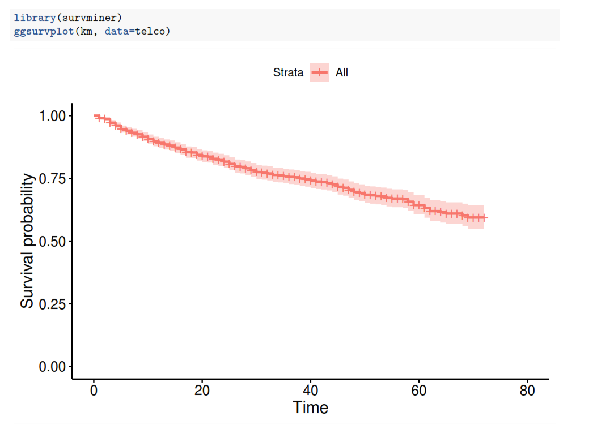
ggplot style with survminer

Slide 27
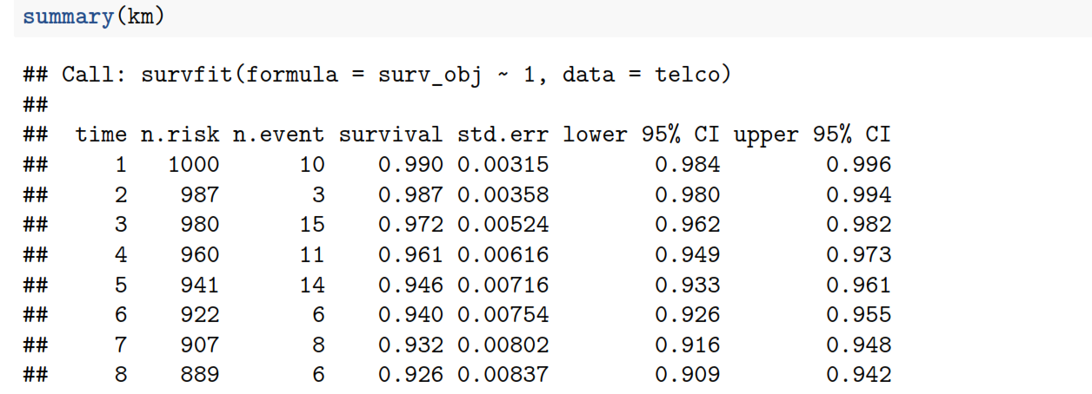
Kaplan-Meier survival analysis
Probability that the customer will not leave the company after month 4 is 0.973

Slide 28
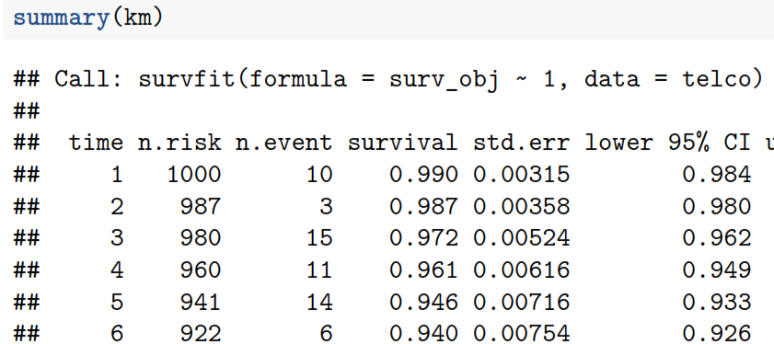
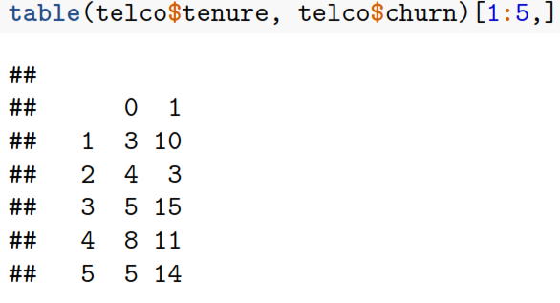
Kaplan-Meier survival analysis
If you just run a table command you will get the same results

Slide 29
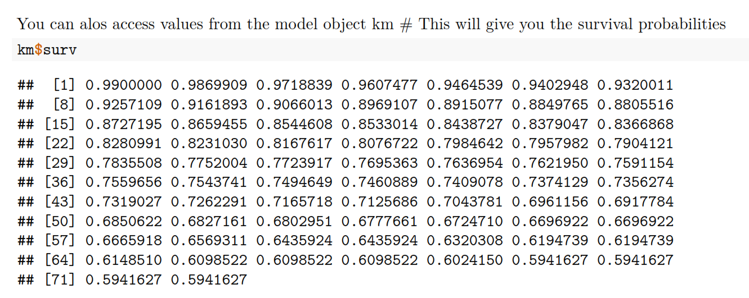
Kaplan-Meier survival analysis

Slide 30
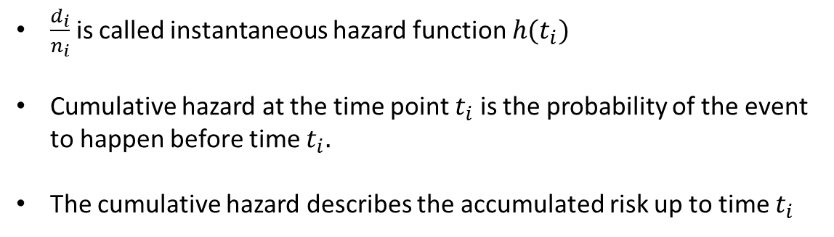
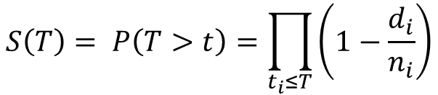

Kaplan-Meier survival analysis
Hazard is the inverse of survival
$$S\left(T\right)= P\left(T>t\right)=\prod_{t_{i}≤T}{\left(1−\frac{d_{i}}{n_{i}}\right)}$$
$\frac{d_{i}}{n_{i}}$ is called instantaneous hazard function $h(t_{i})$
Cumulative hazard at the time point $t_{i}$ is the probability of the event to happen before time $t_{i}.$
The cumulative hazard describes the accumulated risk up to time $t_{i}$
Cumulative hazard is calculated with the following function
$$H(T)=−ln⁡(S(T))$$

Slide 31
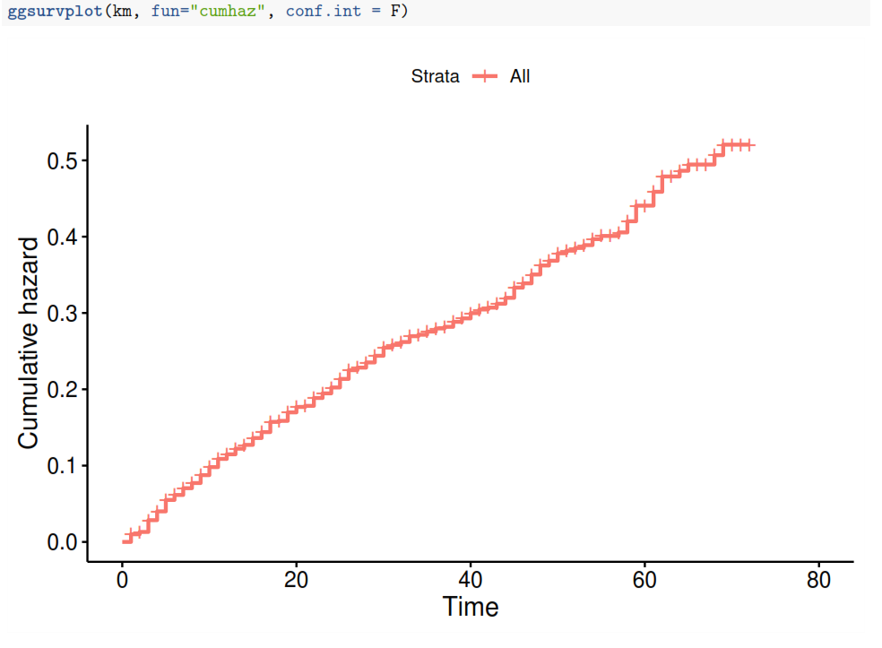
Kaplan-Meier survival analysis
Hazard function: Describes the probability of churn:
set fun=“cumhaz”

Slide 32
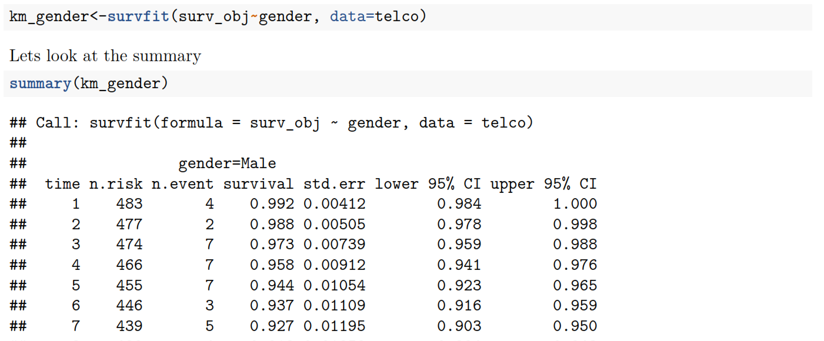
Kaplan-Meier survival analysis
With Kaplan-Meier estimates we can also use covariates, thus create survival curves for different groups.
We want to see if survival is different by gender

Slide 33
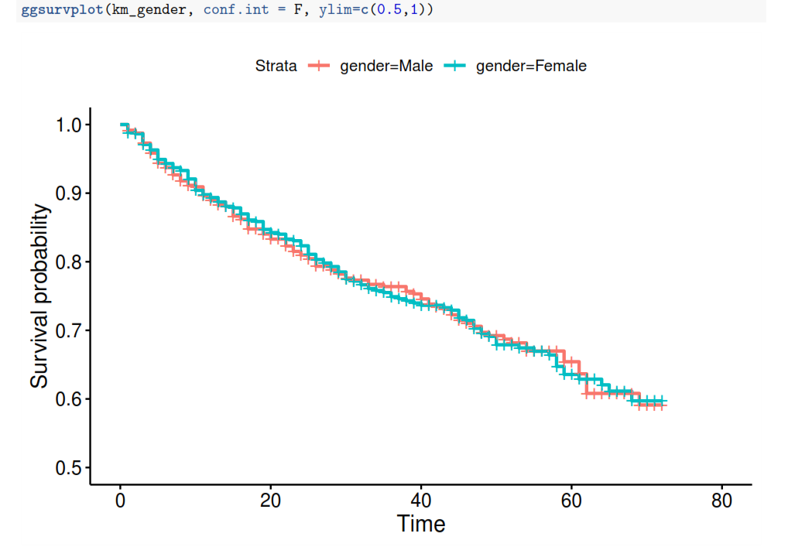
Kaplan-Meier survival analysis
Plot the survival curves for males and females, is there any difference ?

Slide 34
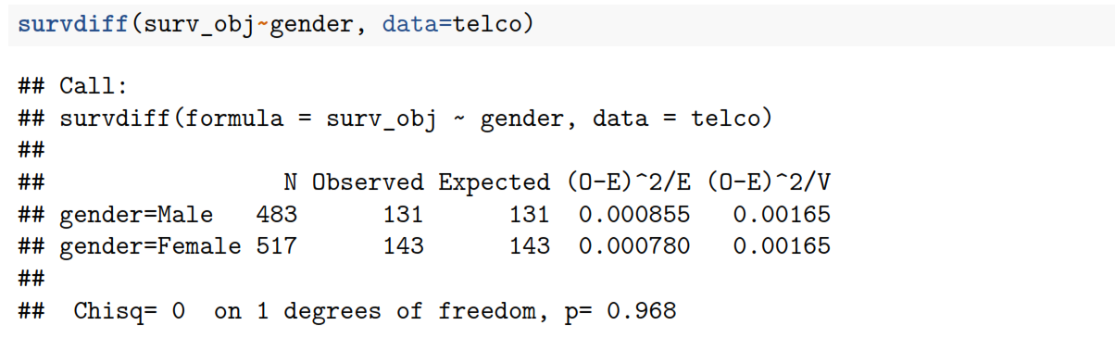
Kaplan-Meier survival analysis
Or we can test an hypothesis
$$H_{0}:Survival curves are not different$$
$$H_{1}:Survival curves are different$$
If p-values < $α$ (0.05) then reject NULL hypothesis

Slide 35
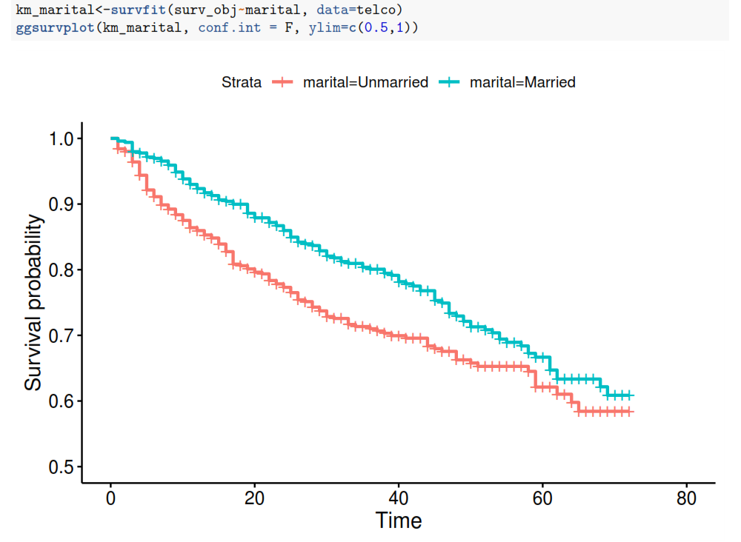
Kaplan-Meier survival analysis
Is the survival different by marital status ?

Slide 36
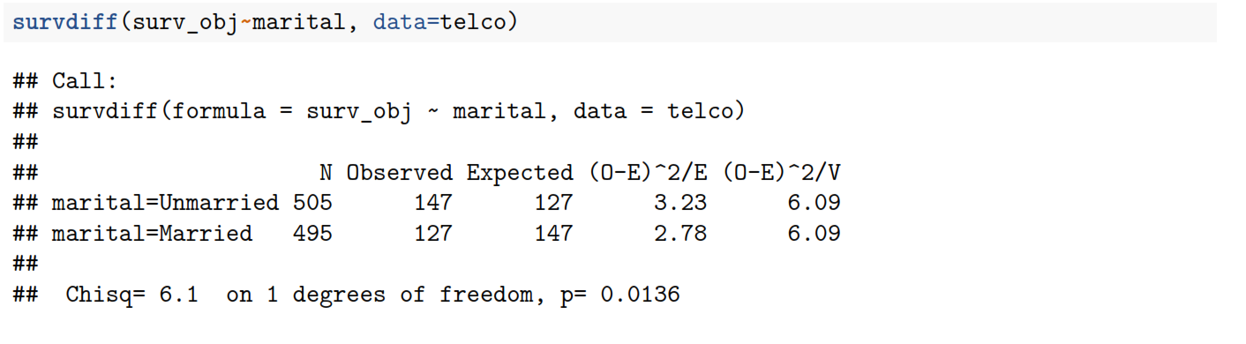
Kaplan-Meier survival analysis
Do the hypothesis testing
$$H_{0}:Survival curves are not different$$
$$H_{1}:Survival curves are different$$
compare p-value to $α=0.05$

Slide 37
Parametric models

Slide 38
Accelerated Failure Time model (ATF)
Regression formula (assuming exponential distribution for time to failure)
$$ln\left(T\right)=β_{0}+β_{1}X_{1}+β_{2}X_{2}…$$
Time independent variables – gender, plan
Time dependent variables – age, inflation
Need to specify the distribution assumed for the time/tenure variable
Options: Exponential
Weibull
Cauchy
Normal distribution, etc
This is called Accelerated Failure Time model, in this case we are predicting the survival time

Slide 39
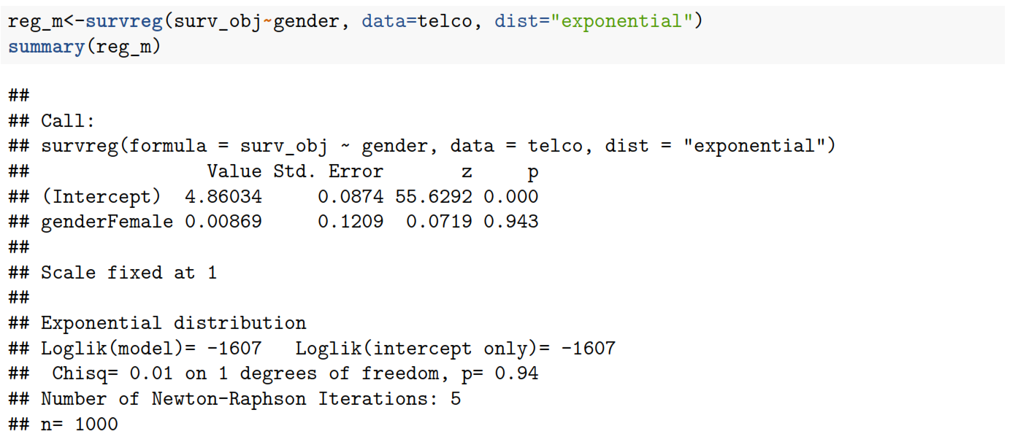
Accelerated Failure Time model (ATF)

Slide 40
Interpreting the coefficients of the model
The interpretations are pretty close to logistic regression
The independent variable is gender,
The baseline category is Male
Regression coefficient is “genderFemale 0.00869”
Positive sign shows longer survival time and smaller hazard
Negative sign shows shorter survival time and higher hazard
So when the gender is female the survival time is increased by (1-exp(0.00869)) percent or by 0.008%

Slide 41
Accelerated Failure Time model (ATF)
Is the predictor significant ? Smaller p-values are better

Slide 42
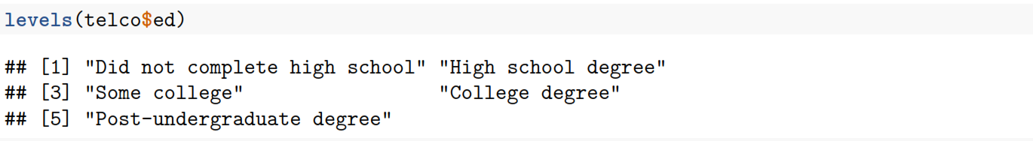
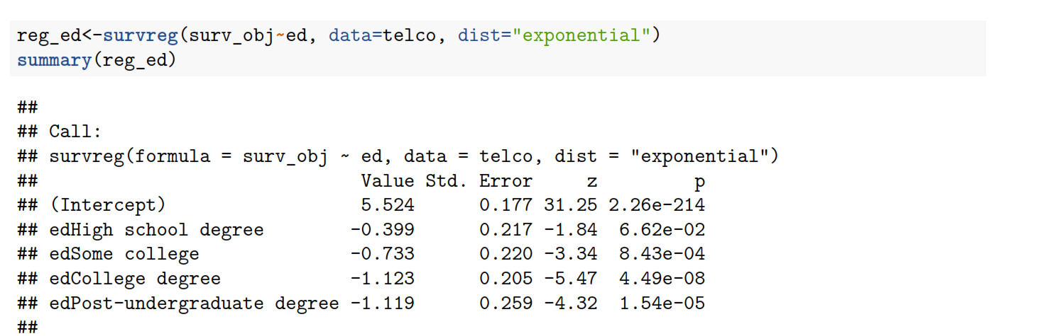
Accelerated Failure Time model (ATF)
Regression on education level
Variable is significant

Slide 43
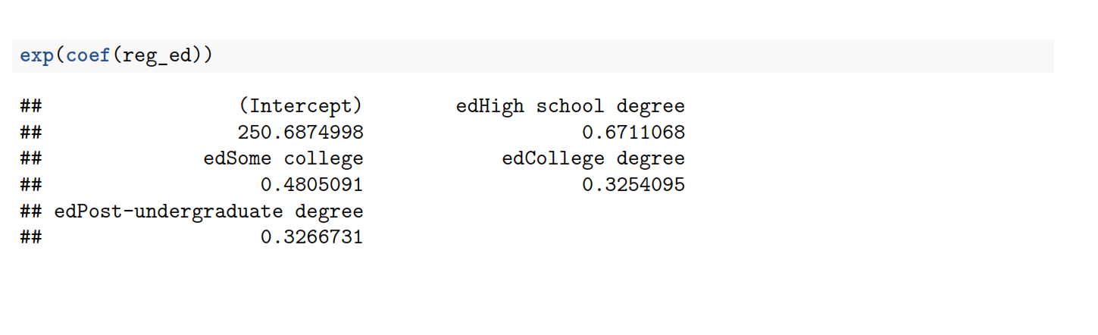
Accelerated Failure Time model (ATF)
Everything is compared to “Did not complete high school”

Slide 44
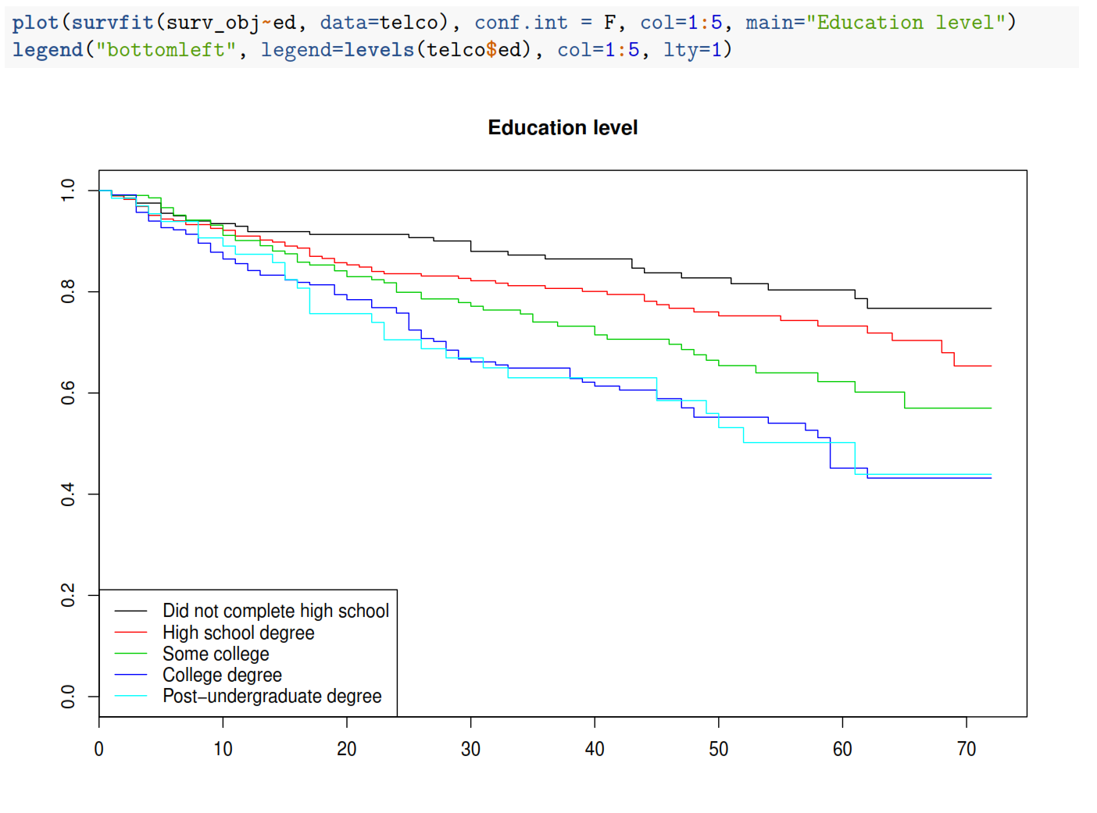
Accelerated Failure Time model (ATF)
Survival curves
The same logic as with regression coefficients

Slide 45
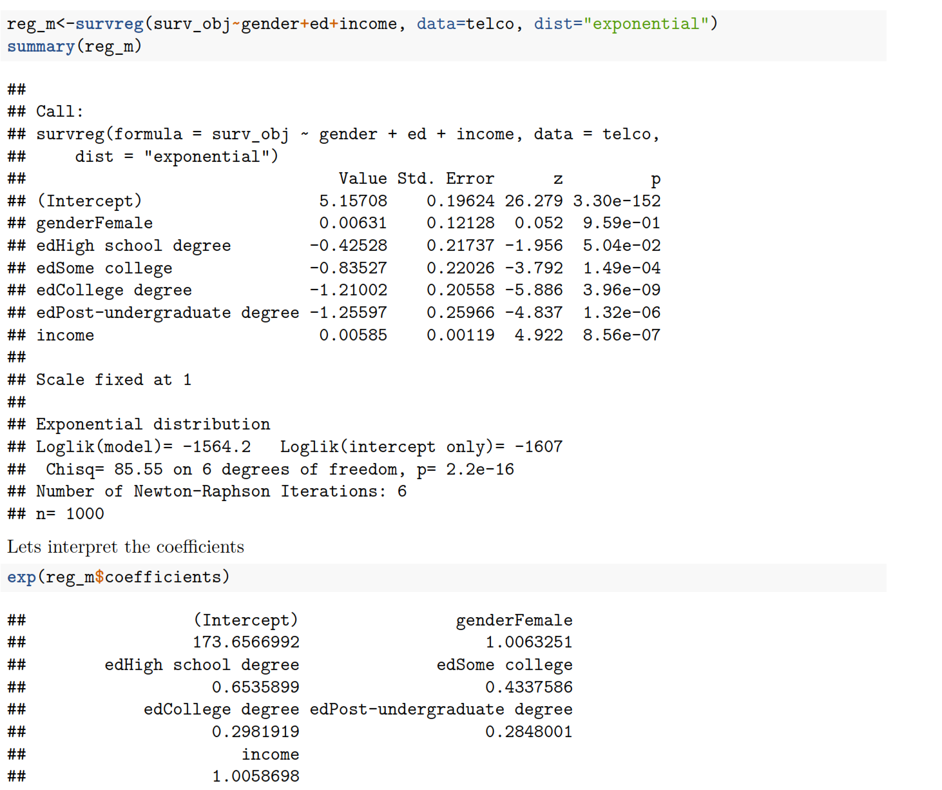
Accelerated Failure Time model (ATF)
Model with several variables together

Slide 46
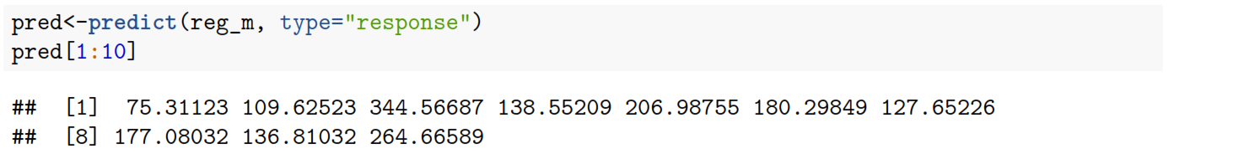
Accelerated Failure Time model (ATF)
Predictions:
Predicted average survival time:
$$ln\left(T\right)=β_{0}+β_{1}X_{1}+β_{2}X_{2}…$$
$$T=e^{β_{0}+β_{1}X_{1}+β_{2}X_{2}…}$$

Slide 47
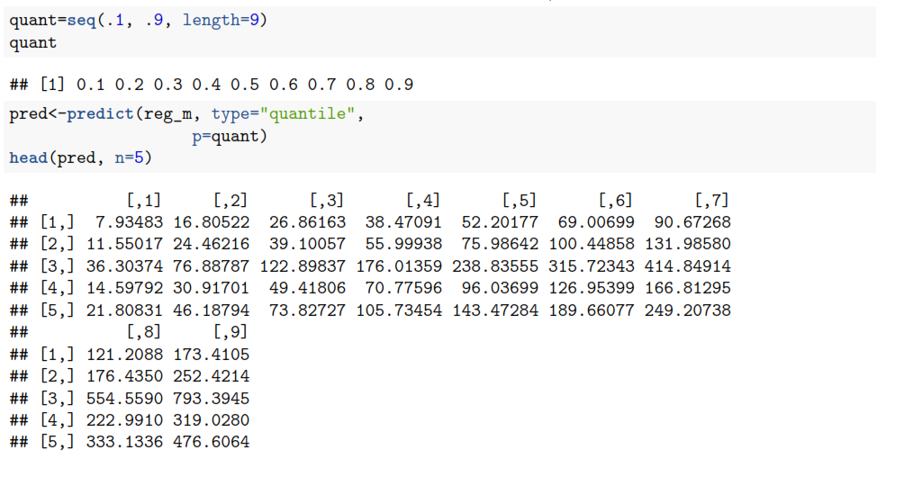
Accelerated Failure Time model (ATF)
Predicting for the quantiles:
Case 1: (Row1): There is 10% chance that he will not survive at month 7.9, 20% chance that it will not survive at month 16.8, and so on

Slide 48
Cox proportional hazard method
Compared to Accelerated time to failure model, for Cox regression the dependent variable is the hazard rather then survival time.
The central statistical output is the hazard ratio.
The Cox Regression procedure is useful for modeling the time to a specified event, based upon the values of given covariates.
One or more covariates are used to predict a status (event).
Data contain censored and uncensored cases. Similar to logistic regression, but Cox regression assesses relationship between survival time and covariates.

Slide 49
Cox Proportional Hazard Model
$$h\left(t|X_{i}\right)=h_{0}\left(t\right)exp⁡(\sum_{j=1}^{n}{β_{j}X_{j}})$$
Hazard function:
$X_{i}$ -n predictors for an individual
$β_{j}$ - the coefficient for the independent variable
$h_{0}\left(t\right)$ - baseline hazard function: The hazard when all predictors are equal to zero
Baseline hazard is free from predictors
Exp part is free from time
We assume that predictors are time independent
Extended versions of Cox regression allow for time varying predictors
It is a semi-parametric model:
We assume that predictors have effect on the hazard
But we don’t have to specify the $h_{0}\left(t\right)$

Slide 50
Cox Proportional Hazard model: Assumptions
The basic Cox Model assumes that the hazard functions for two different levels of a covariate are proportional for all values of t.
For example, if men have twice the risk of heart attack compared to women at age 50, they also have twice the risk of heart attack at age 60, or any other age.

Slide 51
Cox Proportional Hazard model: Assumption
Lets say we have two observations $X_{1},X_{2}$. Then the Hazard ratio will be defined as following:
$$HR=exp⁡(\sum_{j=1}^{n}{β_{j}(X_{2}−X_{1}}))$$
Proportional Hazard assumption: Hazard ratio is independent from time
$$\frac{h(t|X_{2})}{h(t|X_{1})}=\frac{h_{0}\left(t\right)exp⁡(\sum_{j=1}^{n}{β_{j}X_{2}})}{h_{0}\left(t\right)exp⁡(\sum_{j=1}^{n}{β_{j}X_{1}})}=exp⁡(\sum_{j=1}^{n}{β_{j}(X_{2}−X_{1}}))$$
The hazard ratio is the same for all time periods

Slide 52
Cox Regression: coefficient interpetation
Hazard Ratio = $\exp\left(β\right),$ unit increase in predictor variable increases the hazard by a factor of $\exp\left(β\right)$
HR=1: Predictor has no effect on the hazard
HR>1: Predictor increases hazard, thus decreased the survival time
HR<1: Predictor reduce hazard, thus increased the survival time

Slide 53
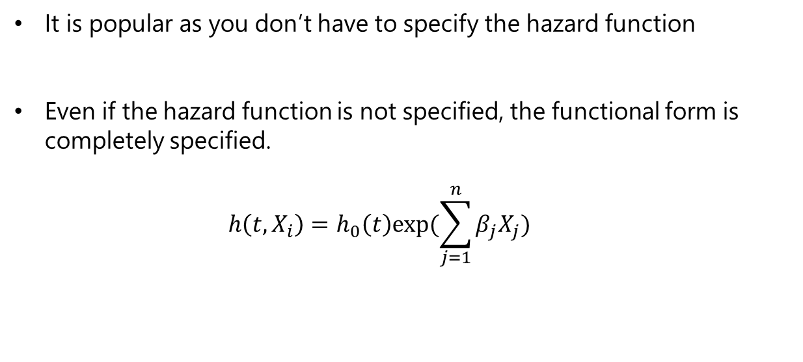
Cox proportional hazard model
It is popular as you don’t have to specify the hazard function
Even if the hazard function is not specified, the functional form is completely specified.
$$h\left(t,X_{i}\right)=h_{0}\left(t\right)exp⁡(\sum_{j=1}^{n}{β_{j}X_{j}})$$

Slide 54
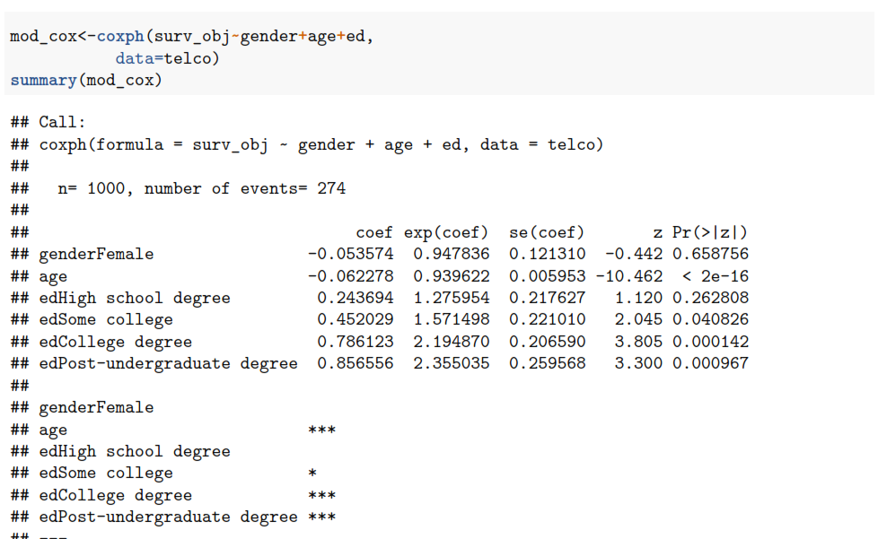
Cox proportional hazard model

Slide 55
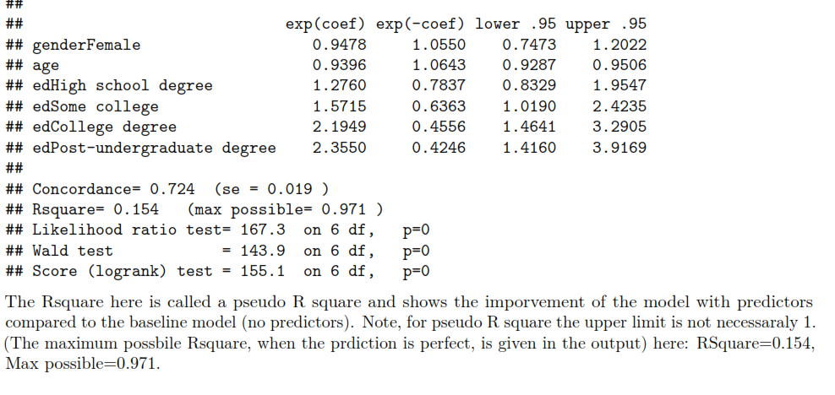
Cox proportional hazard model
The summary also gives you the exponent of the coefficients

Slide 56
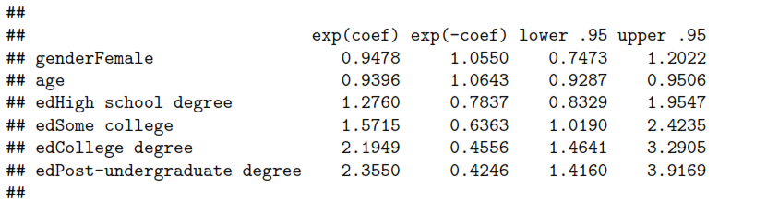
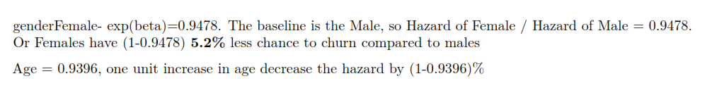
Cox proportional hazard model

Slide 57
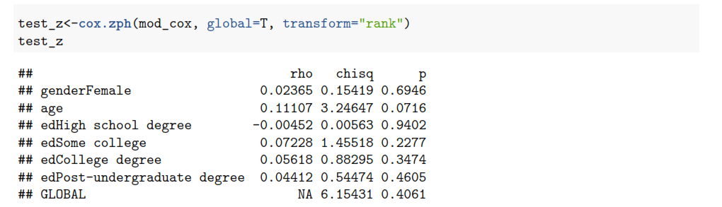
Cox proportional hazard model
Checking proportional hazard assumption
$$H_{0}:Hazard rates are proportional$$
$$H_{1}:Hazard rates are not proportional$$

Slide 58
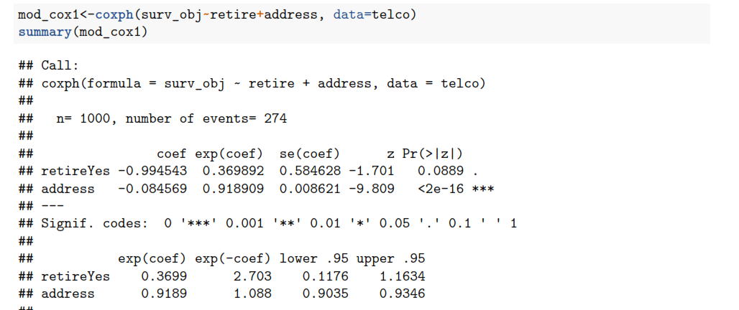
Cox proportional hazard model
Cox model helps us to predict hazard at the given time period
Lets build a simple model: with two variables: address (how many years does the person lives in his current address) and retired
In telco case: predict probability of churn at week 20
given that A person is retired, and is living at his current address for 9 years

Slide 59
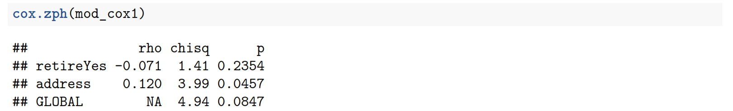
Cox proportional hazard model
Proportional Hazard assumption holds for all the variables (address has borderline p-value)

Slide 60
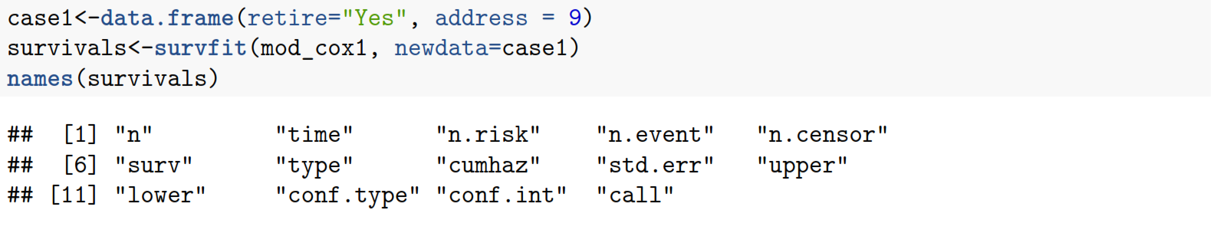
Cox proportional hazard model
Make prediction for 1 case: Retired and living 9 years in current address
Create a dataframe with the case
Use survfit with Cox model output as an argument for formula
Look what is inside the object

Slide 61
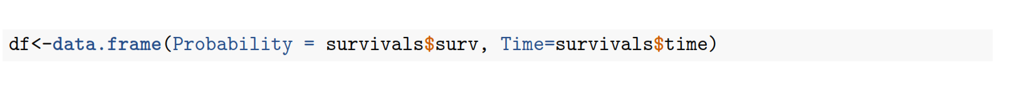
Cox proportional hazard model
Make a dataframe with Survival probabilities (survivals$surv) and Time variable (survival$time)

Slide 62
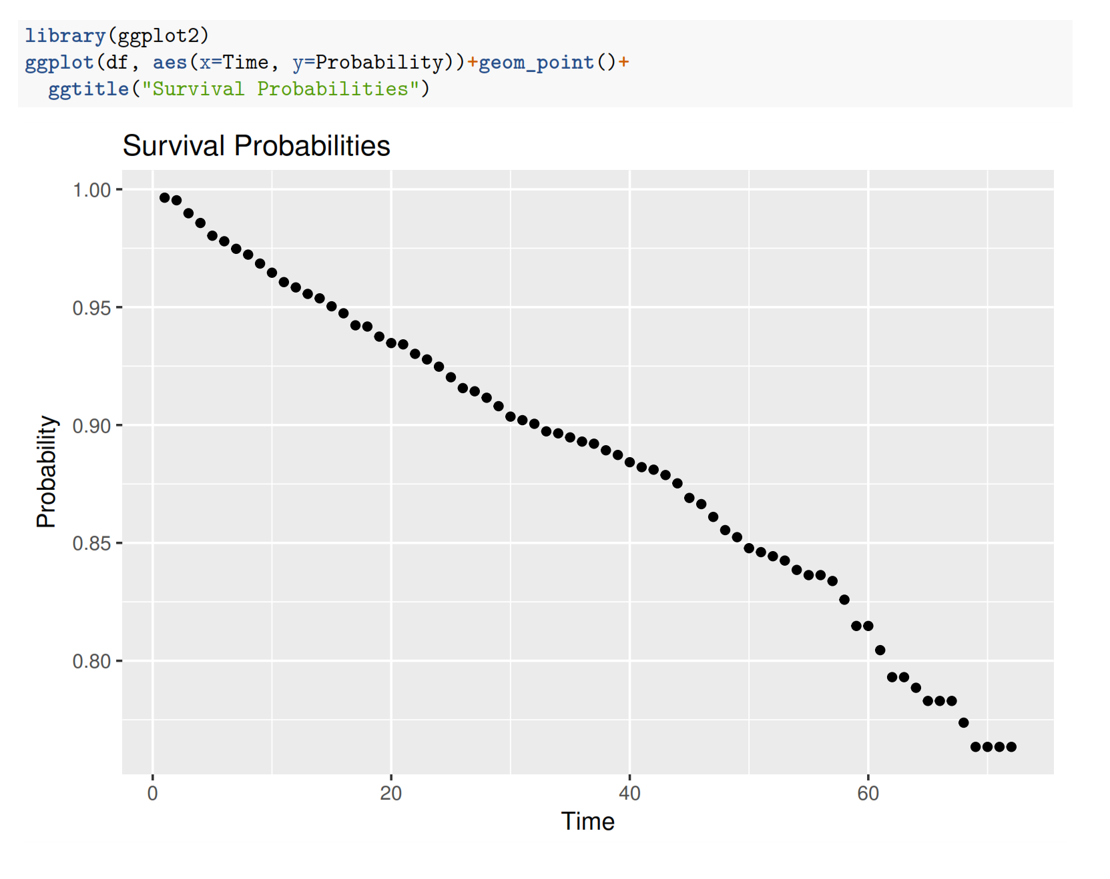
Cox proportional hazard model
Survival plot

Slide 63
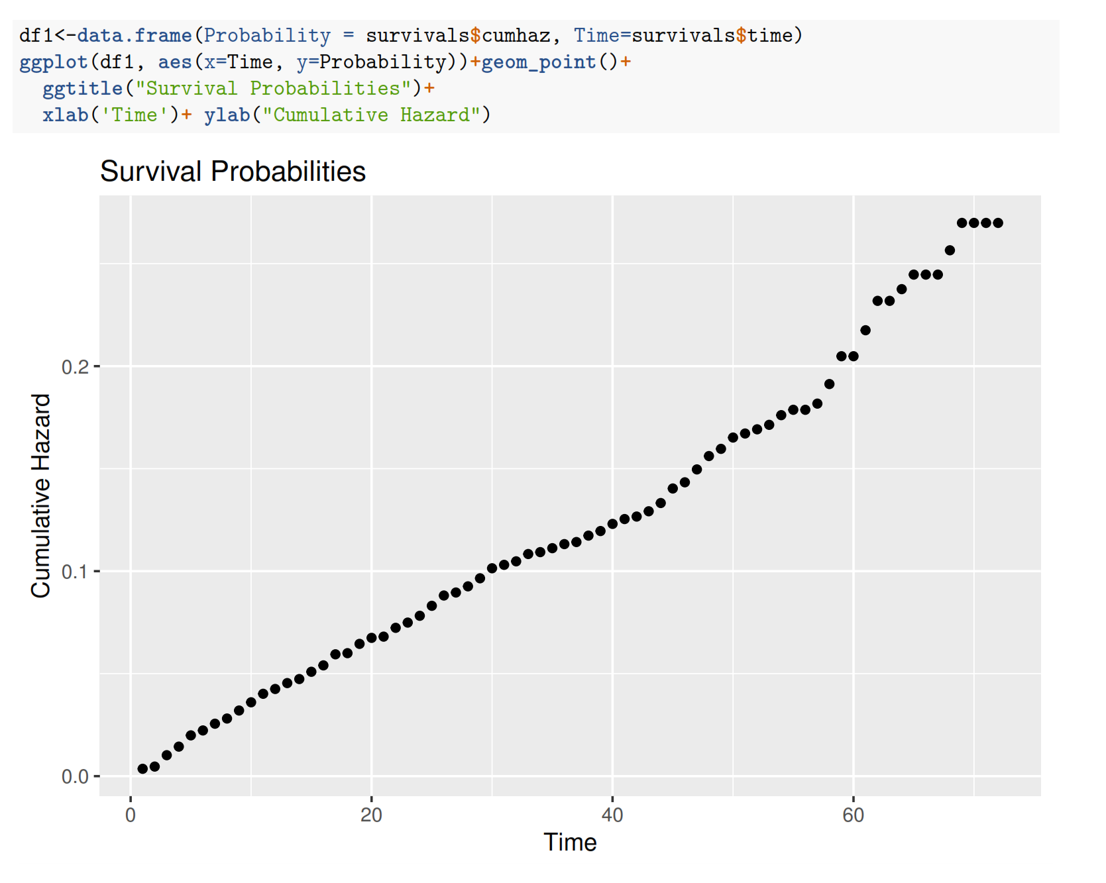
Cox proportional hazard model
Cumulative hazard function:
Probability of Hazard (churn) before time t

